Slide 1

BAYMAX
ARCHITECTURE DIAGRAM
MODULES DESCRIPTION
FEASIBILITY STUDY
Your Personal
AI Care Taker

Slide 2
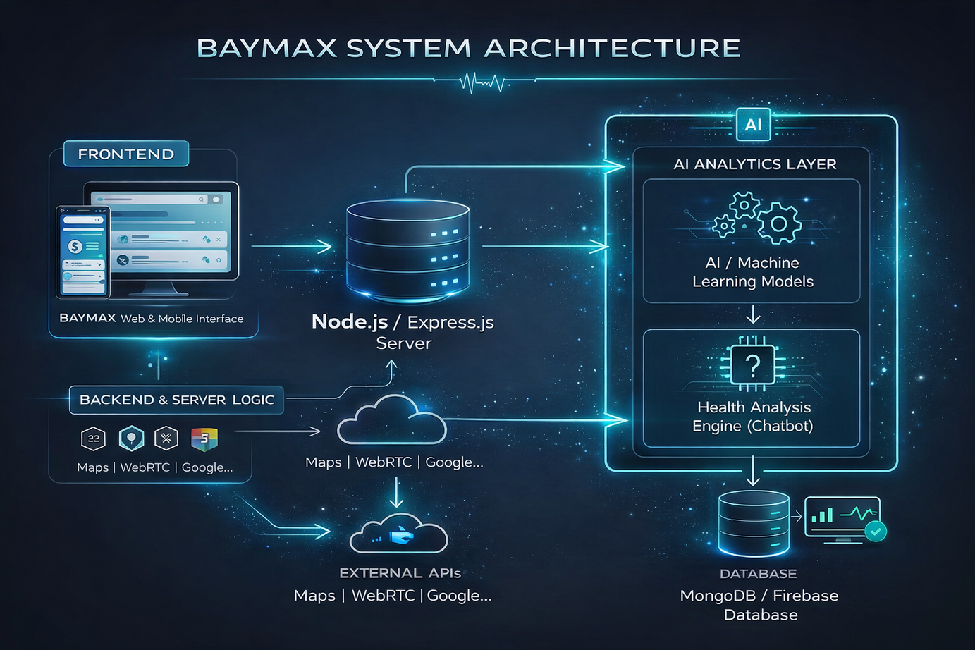
ARCHITECTURE DIAGRAM

Slide 3
MODULES DESCRIPTION
1. User Authentication & Profile Management
  Secure user registration and login with personal health profile management.
2. Illness Input & AI Symptom Analysis
  Users enter symptoms; AI analyzes inputs and provides preliminary health insights.
3. Doctor Consultation Management
  Appointment booking
4. Online Consultation
  Real-time video and chat consultation with doctors using WebRTC
5. Pharmacy & Medicine Services
  Displays nearby pharmacies with medicine availability and pricing.
6. Medicine Information & Reminder
  Provides medicine usage details and prescription-based reminders.

Slide 4
MODULES DESCRIPTION
  7. Diagnostic & Lab Test
  Enables lab test booking and digital access to medical reports.
  8. Insurance Policy Assistance
  Helps users view and compare suitable health insurance policies.
  9. AI Health Assistant & Personal Trainer
  AI chatbot offers basic health guidance, fitness, and diet suggestions.
  10. Blood Donation & Emergency Support
  Connects blood donors with emergencies and provides SOS services.
  11. Health Dashboard & Monitoring
  Centralized dashboard for appointments, reminders, and health activities.

Slide 5
FEASIBILITY STUDY
1. TECHNICAL FEASIBILITY:
• Uses React.js, Node.js, AI APIs, and WebRTC
• Runs efficiently on standard computer systems
2. OPERATIONAL FEASIBILITY:
• Easy-to-use and user-friendly interface
• Reduces manual effort and waiting time
3. ECONOMIC FEASIBILITY:
• Uses open-source tools and free resources
• Low development and maintenance cost
4. SCHEDULE FEASIBILITY:
• Modular design enables phased development
• Can be completed within academic timeline
5. LEGAL & ETHICAL FEASIBILITY:
• Ensures secure handling of user health data
• AI acts only as a decision-support system

Slide 6
Thank you!

